Slide 1
LiDAR Processing and Target Identification – Changepoint Detection MSU ECE REU Site Summer 2022 Final Project Presentation
Presenter: Caroline Xu
Mentor: Dr. Brad Whitaker
Co-authors: Trevor Vannoy, Nat Sweeney, Ryan Ficken

Slide 2
Introduction
Entomologists want to study insect behavior using LiDAR
Agriculture
Species conservation
Inefficient to manually look through images
Use machine learning techniques to automate process to speed up insect identification

Slide 3
Research Question
How can we use changepoint detection to create an unsupervised machine learning algorithm to detect insects in LiDAR images?
Can we use changepoint detection as an alternative to supervised machine learning methods?

Slide 4
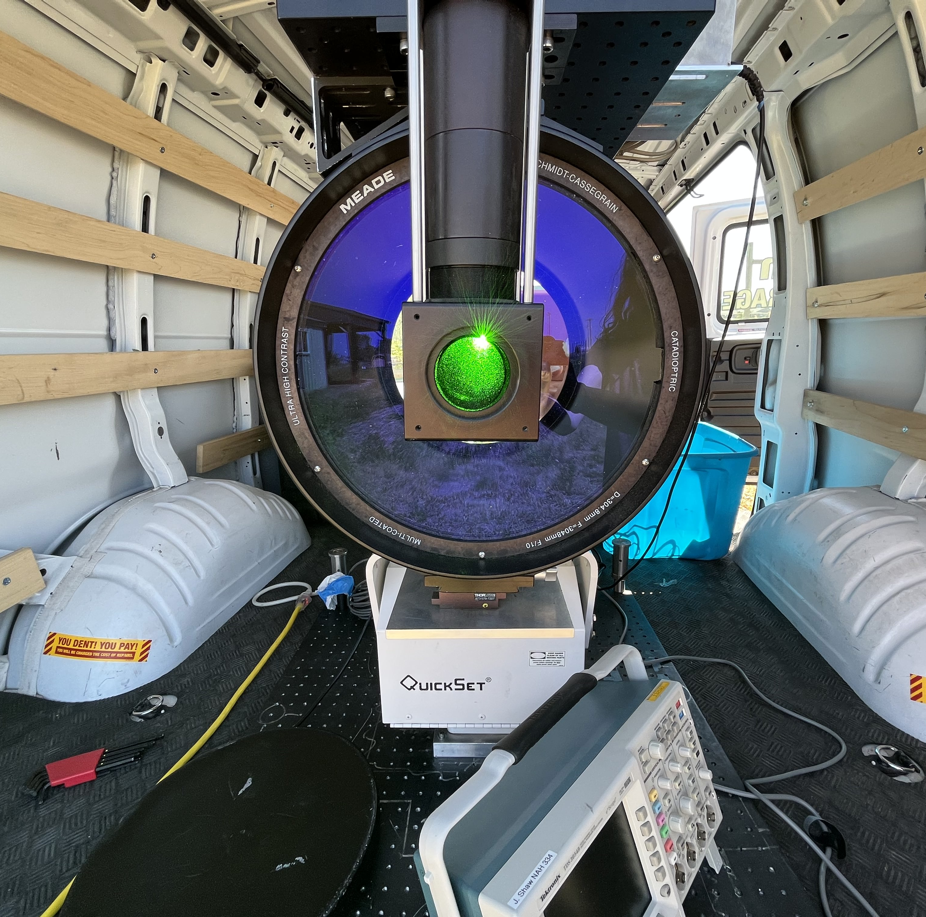
LiDAR
Light Detection And Radar
Shoots laser out and receives a return signal when it hits something
6kHz-8kHz pulse frequency
Beam is ~5 cm in diameter
Trevor Vannoy, MSU, 2022

Slide 5
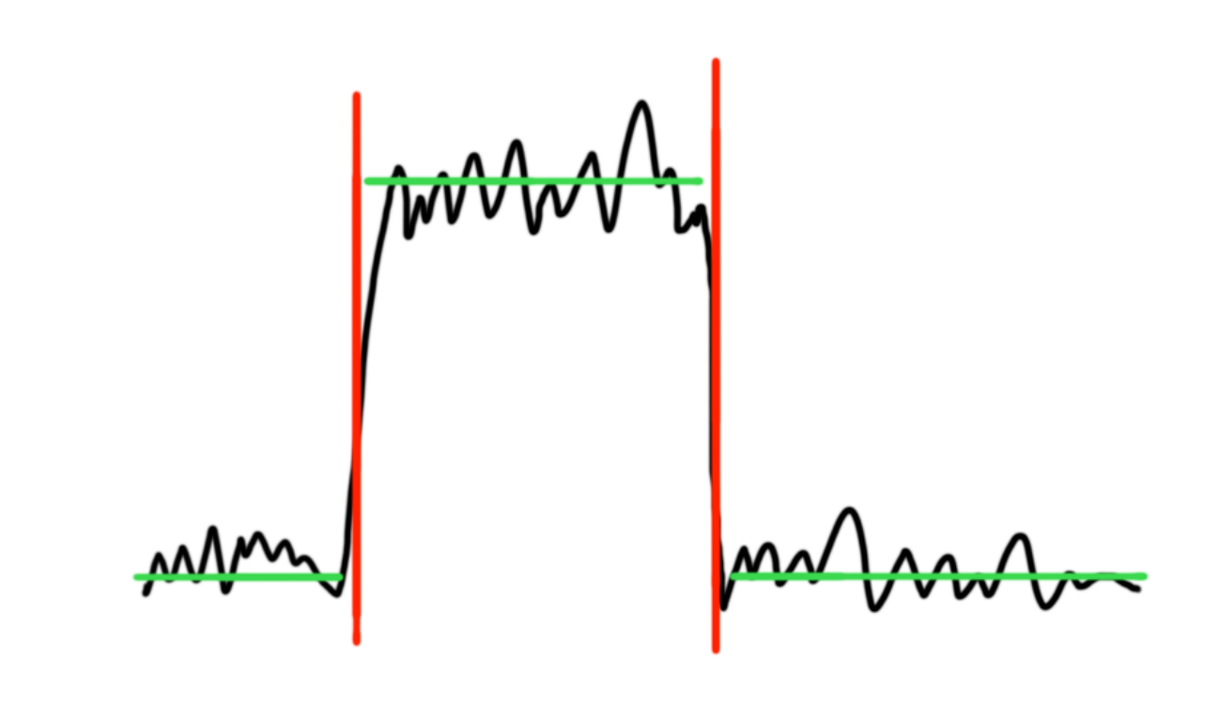
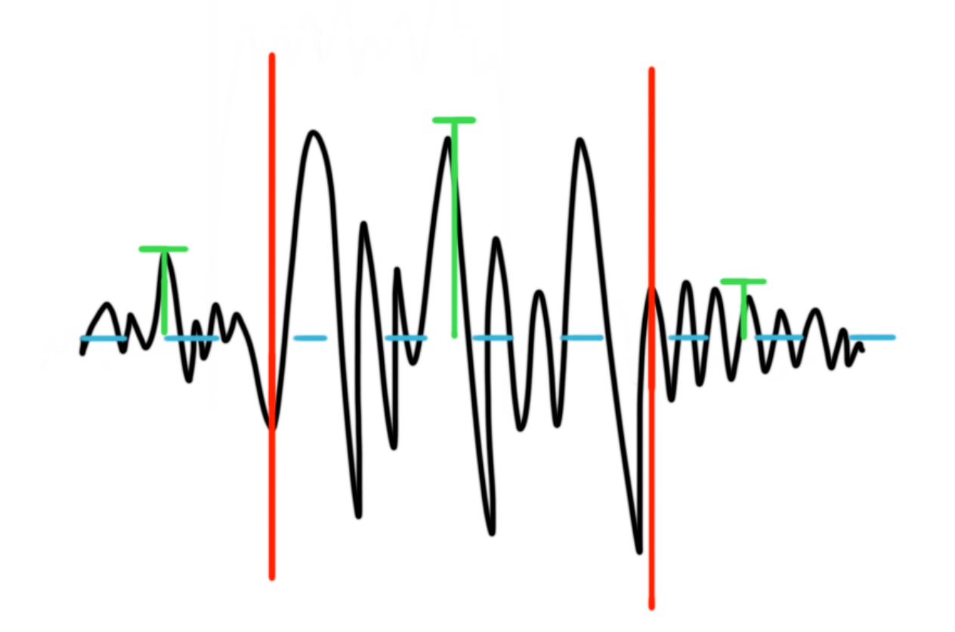
Changepoint Detection
Type of unsupervised learning: figures out differences by itself
Looks at changes in data
Mean
Variance/Standard Deviation
Notes:
explain why use mean and how it actually works

Slide 6
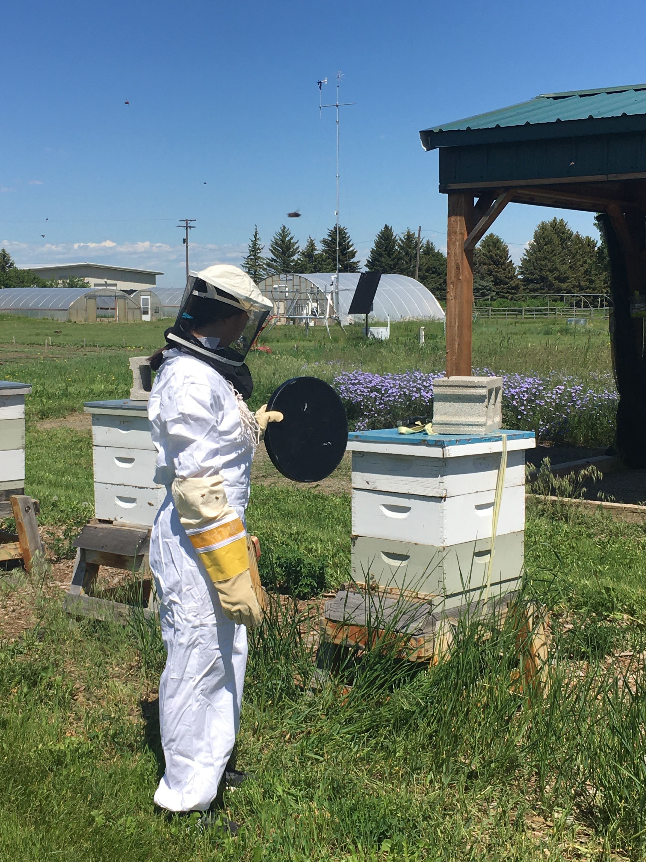
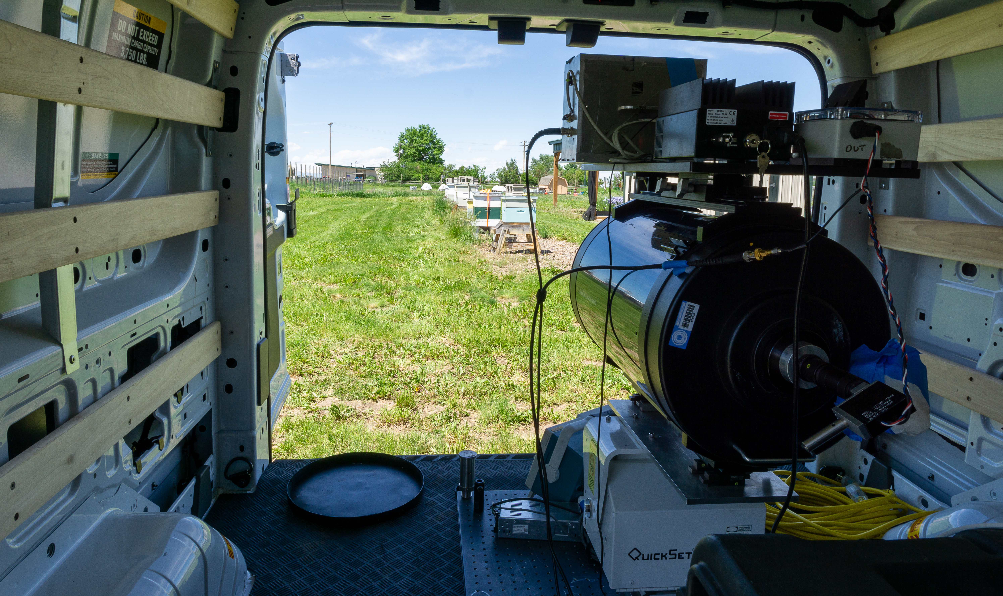
Data Collection
Hyalite Creek (2020)
09/16 – 09/18, 09/20
10,079 images
MSU Honey Bee Research Site and Pollinator Garden (2022)
06/23 – 06/24
4132 images
Images are 178x1024 pixels
178 range bins ~ 0.5 m
1024 pulses → ~ 128-170 milliseconds
Images used are normalized to values 0 - 1
Joe Shaw and Trevor Vannoy, MSU, 2022

Slide 7
Methodology
Find ways to preprocess the data
Use processed data and input into changepoint functions
Look at results
Runtime
Accuracy
Adjust code as necessary to improve performance
Repeat

Slide 8
Methodology
Input Processed Data into Changepoint Detection Functions
Preprocess Data
Repeat
Look at Results
(Runtime and Accuracy)
Adjust Code to Improve Performance
No
Is Performance Satisfactory?
Apply Algorithm on New Data
Yes

Slide 9
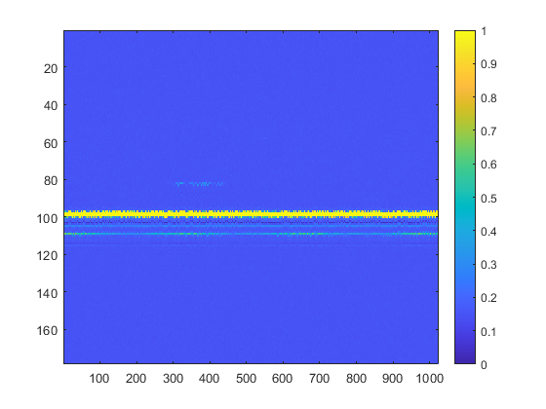
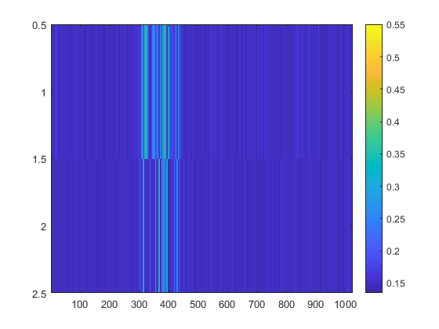
Preprocessing

Slide 10
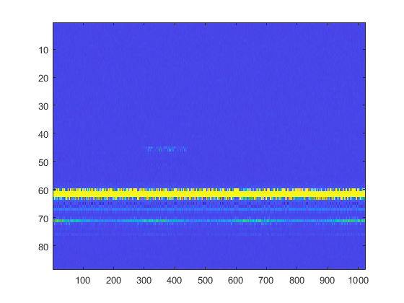
Preprocessing (Row Removal)
Removed Empty Rows

Slide 11
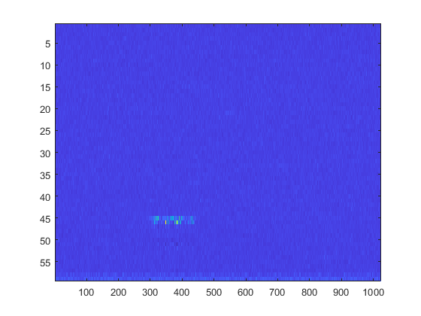
Preprocessing (Row Removal)
Removed Hard Targets

Slide 12
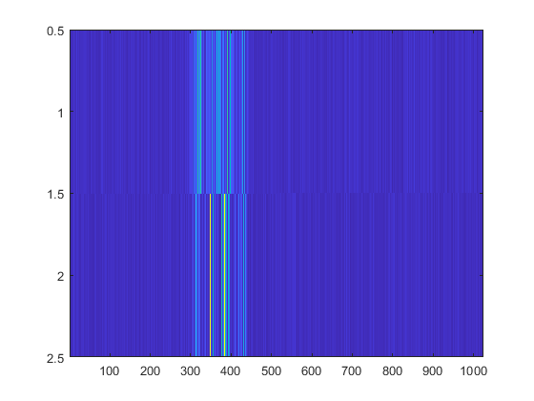
Preprocessing (Row Removal)
Removed Rows With No Change

Slide 13
Preprocessing (Row Removal)
Removed Rows With No Frequency
(no change)
Notes:
Explain that removing rows did not remove insects for Hyalite, can assume same for bee dataset

Slide 14
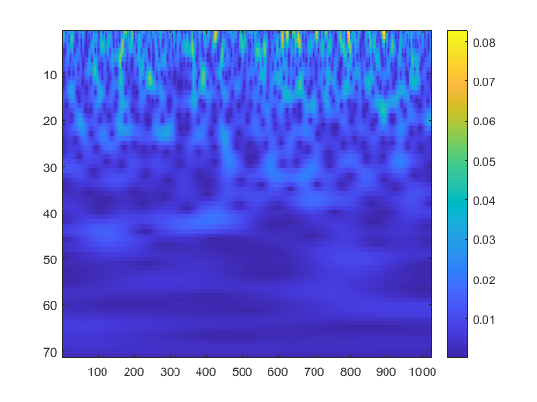
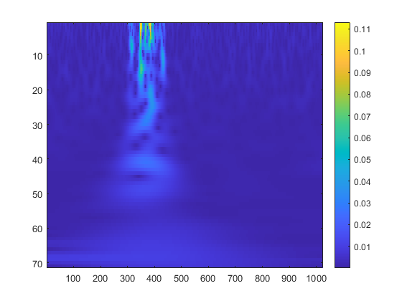
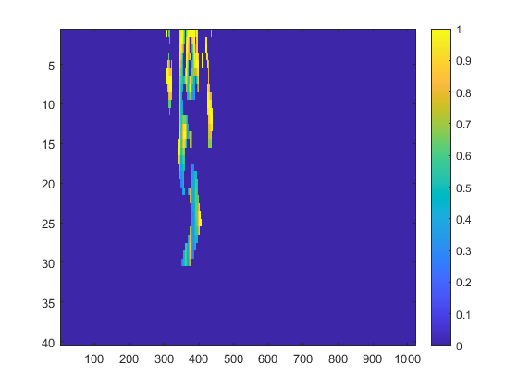
Preprocessing (Wavelet Transform)
Continuous Wavelet Transform (cwt) Scalogram
Cropped, Processed, and Normalized Scalogram

Slide 15
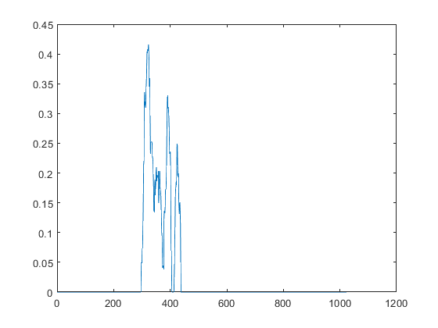
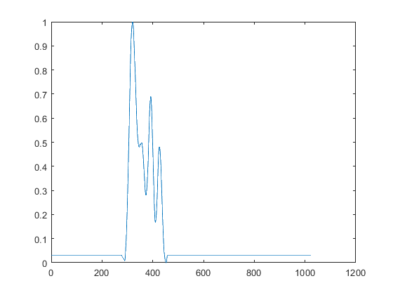
Preprocessing (Wavelet Transform)
Average of Each Column in Normalized Scalogram
Smoothed and Normalized Signal

Slide 16
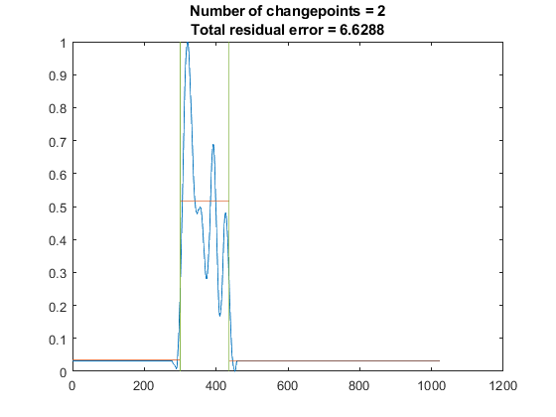
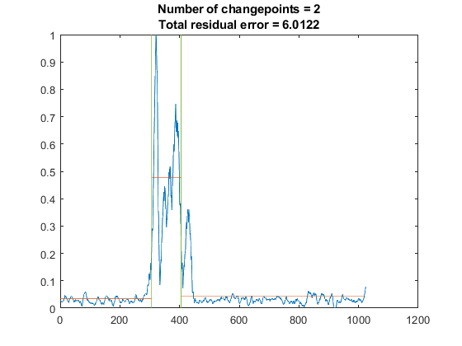
Changepoint Functions
Changepoint Detection on Smoothed Scalogram Signal
Changepoint Detection on Original Signal

Slide 17
Post Processing
Identify insect position using mean of signal between each changepoint
Can look at position of each insect instead of entire image
Remove insects that were too short or too long
< 15 pixels or > 700 pixels
Plot column in insect position to check for maximum value at correct row

Slide 18
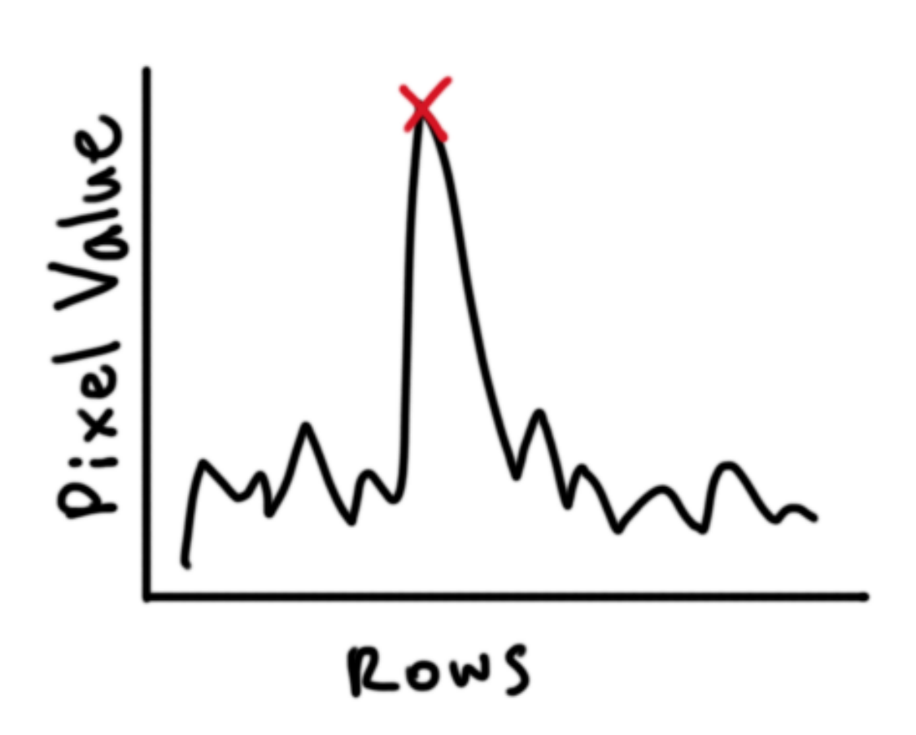
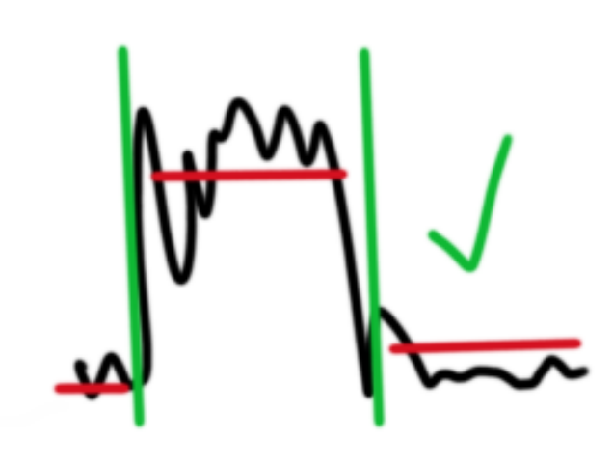
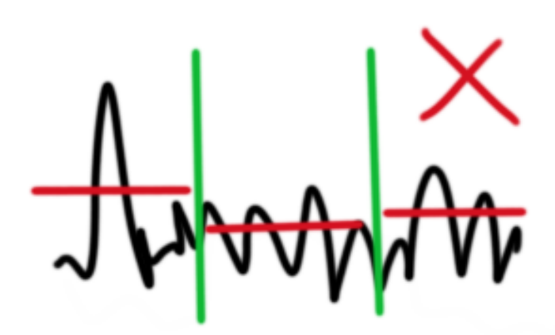


Post Processing
Examine Row Signal
Enough Change
Examine Insect Length
Length Between 15 & 700
Not Enough Change
< 15 or > 700
Plot Column
Peak Doesn't Match Row
Peak Matches Row

Slide 19
Algorithms
Insect Algorithm
Bee Algorithm
Minimum threshold for changepoints were 3.9 and 3
Less sensitivity means only confident on significant signals
Minimum of 15 pixels, maximum of 605 pixels
Not as many long insect signals in Hyalite dataset
Did not plot columns
Minimum threshold for changepoints were 2 and 0.8
Increased sensitivity means more changepoints
Minimum of 15 pixels, maximum of 700 pixels
Long signals more common in bee dataset
Plotted columns

Slide 20
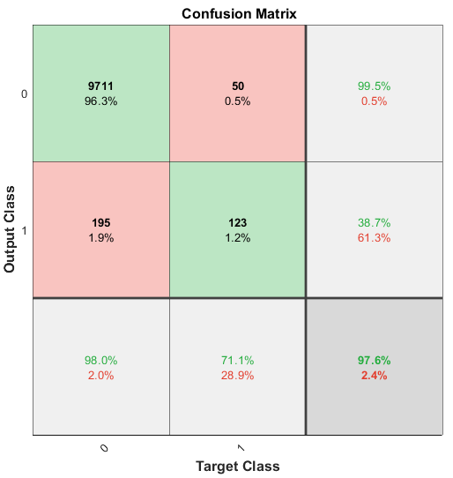
Hyalite Dataset Results
Used insect algorithm
Runtime of 4 hours for 10079 images
97.6% accuracy
Identified 71.1% of all insects
195 false positives
2% of all images without insects were falsely identified to have insects

Slide 21
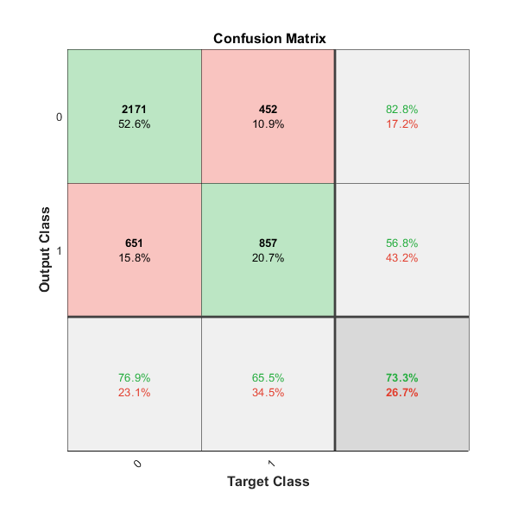
Bee Dataset Results
Used bee algorithm
Runtime of 2 hours 15 minutes for 4132 images
73.3% accuracy
Identified 65.5% of all insects
651 false positives
23.1% of all images without insects were falsely identified to have insects

Slide 22

Bee Dataset Results
Used insect algorithm
Runtime of 2 hours 50 minutes for 4132 images
81.4% accuracy
Identified 51.3% of all insects
132 false positives
4.7% of all images without insects were falsely identified to have insects

Slide 23
Analysis
It took 5 hours 5 minutes to run both algorithms on the bee data linearly
It took 35 hours to manually label all of the bee images taken over the course of two days
Split between 5 people
Took 5 days to complete

Slide 24
Analysis
Insect algorithm does not perform as well as it looks
Less insects and more images in the dataset
False positives and false negatives have smaller impact
More false positives than actual positives
Algorithms on bee dataset can be improved
Less false positives than actual positives
Still missing a lot of insect images

Slide 25
Analysis
Mainly caught the prominent signals
Weak or noisy signals could not be identified
Because of wavelet transform, bright DC signals within the insect signal did not show up in scalogram
No frequency detected
Performance still not ideal
Too many false positives; decent results by chance?
Signals seen in data might not be insects
No way to verify

Slide 26
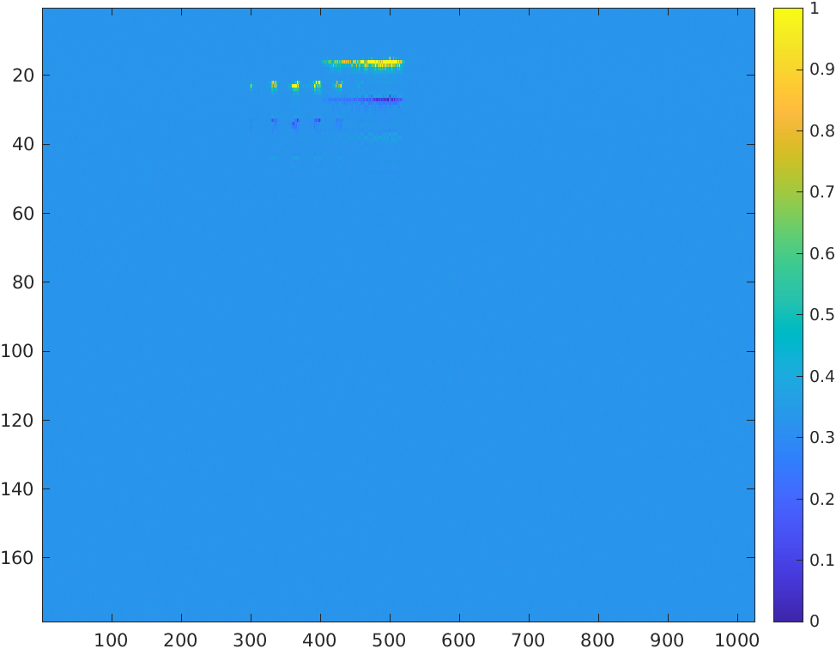
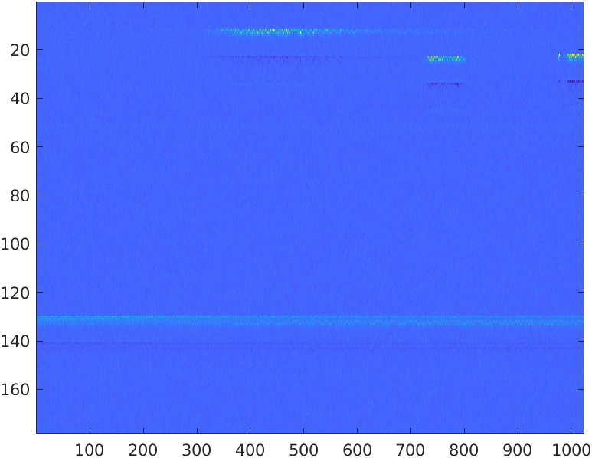
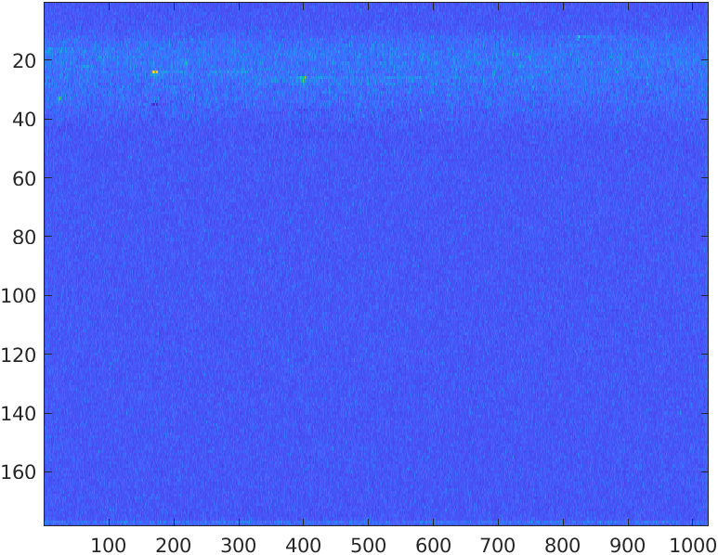
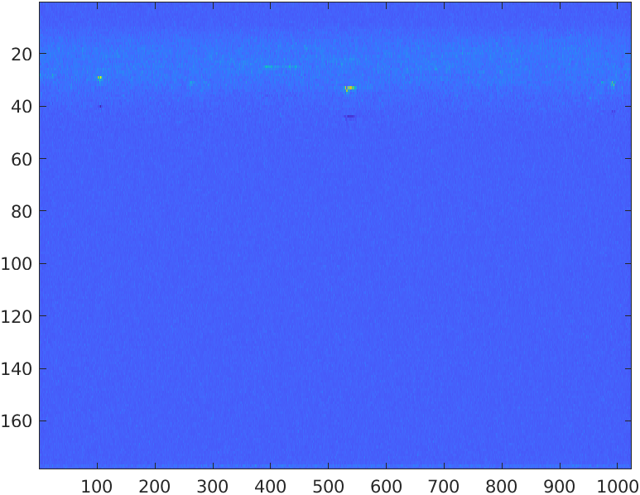
Analysis
Nearly impossible to create perfect algorithm
Variety of insect signals

Slide 27
Conclusions
Changepoint detection can be a viable replacement to supervised machine learning
Greatly reduces time to go through all the images
Relatively accurate
Future Directions:
Improve accuracy and runtime of models
Use voltage matrix instead of normalized matrix
Find faster way to reduce rows
Run everything in parallel instead of linearly
Pinpoint reason behind false negatives and false positives
Look at other changepoint detection functions like gfpop[1]
[1] Hocking, T. D., Rigaill, G., Fearnhead, P., & Bourque, G., "Generalized functional pruning optimal partitioning (gfpop) for constrained changepoint detection in genomic data," arXiv, 2018.

Slide 28
Broader Impacts
Technical:
Changepoint detection can be used instead of supervised ML in similar scenarios (drone detection, etc.)
Personal:
Learned a lot about signal processing and gained experience with unsupervised ML and field tests
Learn more about grad school as a future option
Go back to school and look for research to do
Apply engineering thinking skills to project teams and school

Slide 29
Acknowledgements
Dr. Brad Whitaker
Project Mentor
Dr. Kevin Repasky and Dr. Wataru Nakagawa
Principal Investigator (PI) and Co-PI
Trevor Vannoy
Graduate Student Behind the Research Project
Dr. Joe Shaw
Built the insect LiDAR
Nat Sweeney
Changepoint Detection Buddy
ECE REU Students
Thank you!

